Slide 1
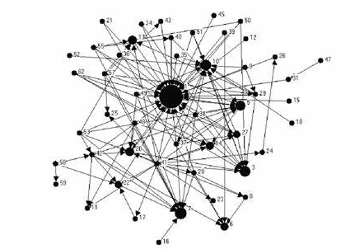
Sources
Warrants
Claims
Are there identifiable features of students’ citation practices that we can use as insights for our teaching?
Notes:
Moore, Spencer & Shiell, Alan & Hawe, Penelope & Haines, Valerie. (2005). The Privileging of Communitarian Ideas: Citation Practices and the Translation of Social Capital Into Public Health Research. American Journal of Public Health. 95. 1330-7. 10.2105/AJPH.2004.046094.

Slide 2
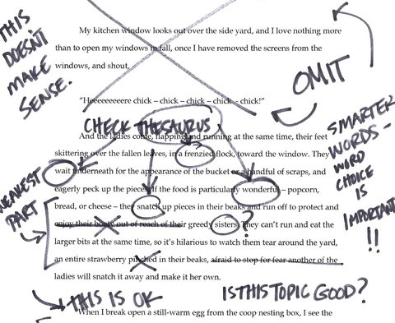
The data I used
Noisy!
Complex
Closed
Inconsistent
Incomplete
Notes:
UG dissertation, part 1
Specialised but …
Selection – marked before I knew I was to use them
Similar standard
Closed source
Ethics – practitioner research

Slide 3
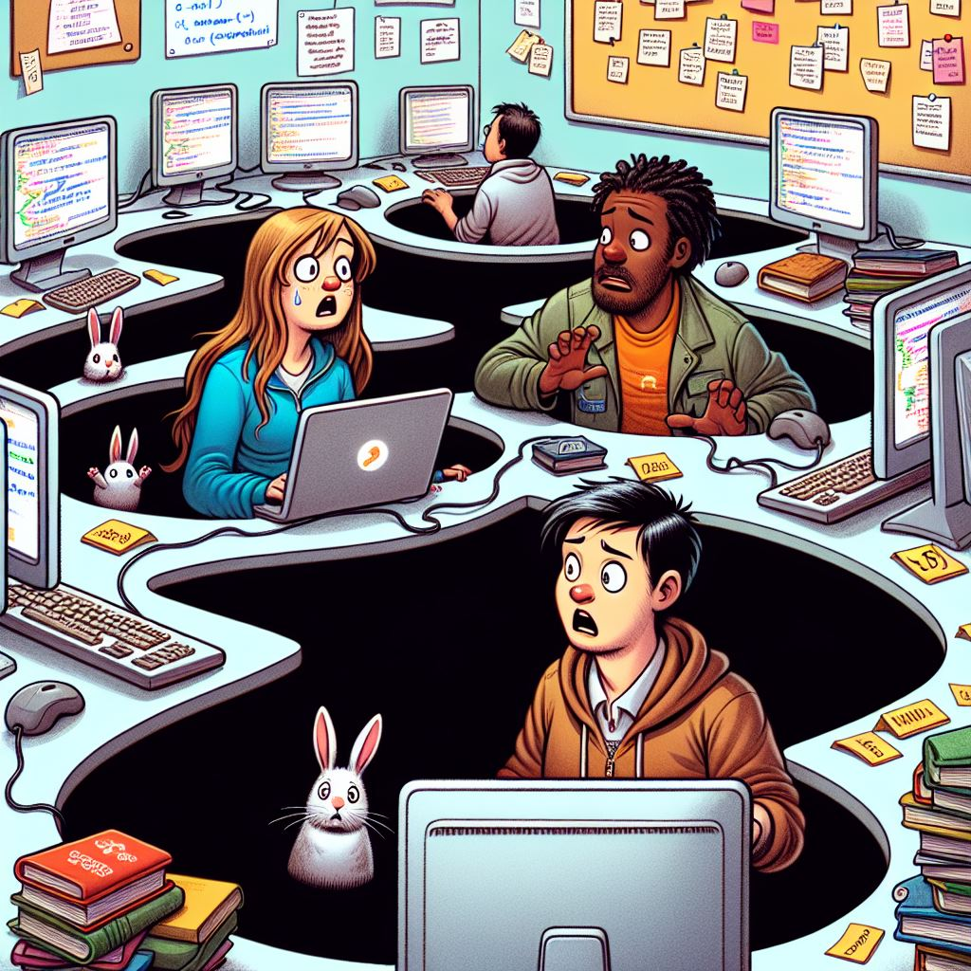
Rabbit holes I ‘investigated’
Scripts: Ruby – anystyle.io
APIs: Openalex.org, Semanticscholar
Commerce: Connectedpapers.com
Packages: Networkx, Litstudy
Teary joy: Vosviewer

Slide 4
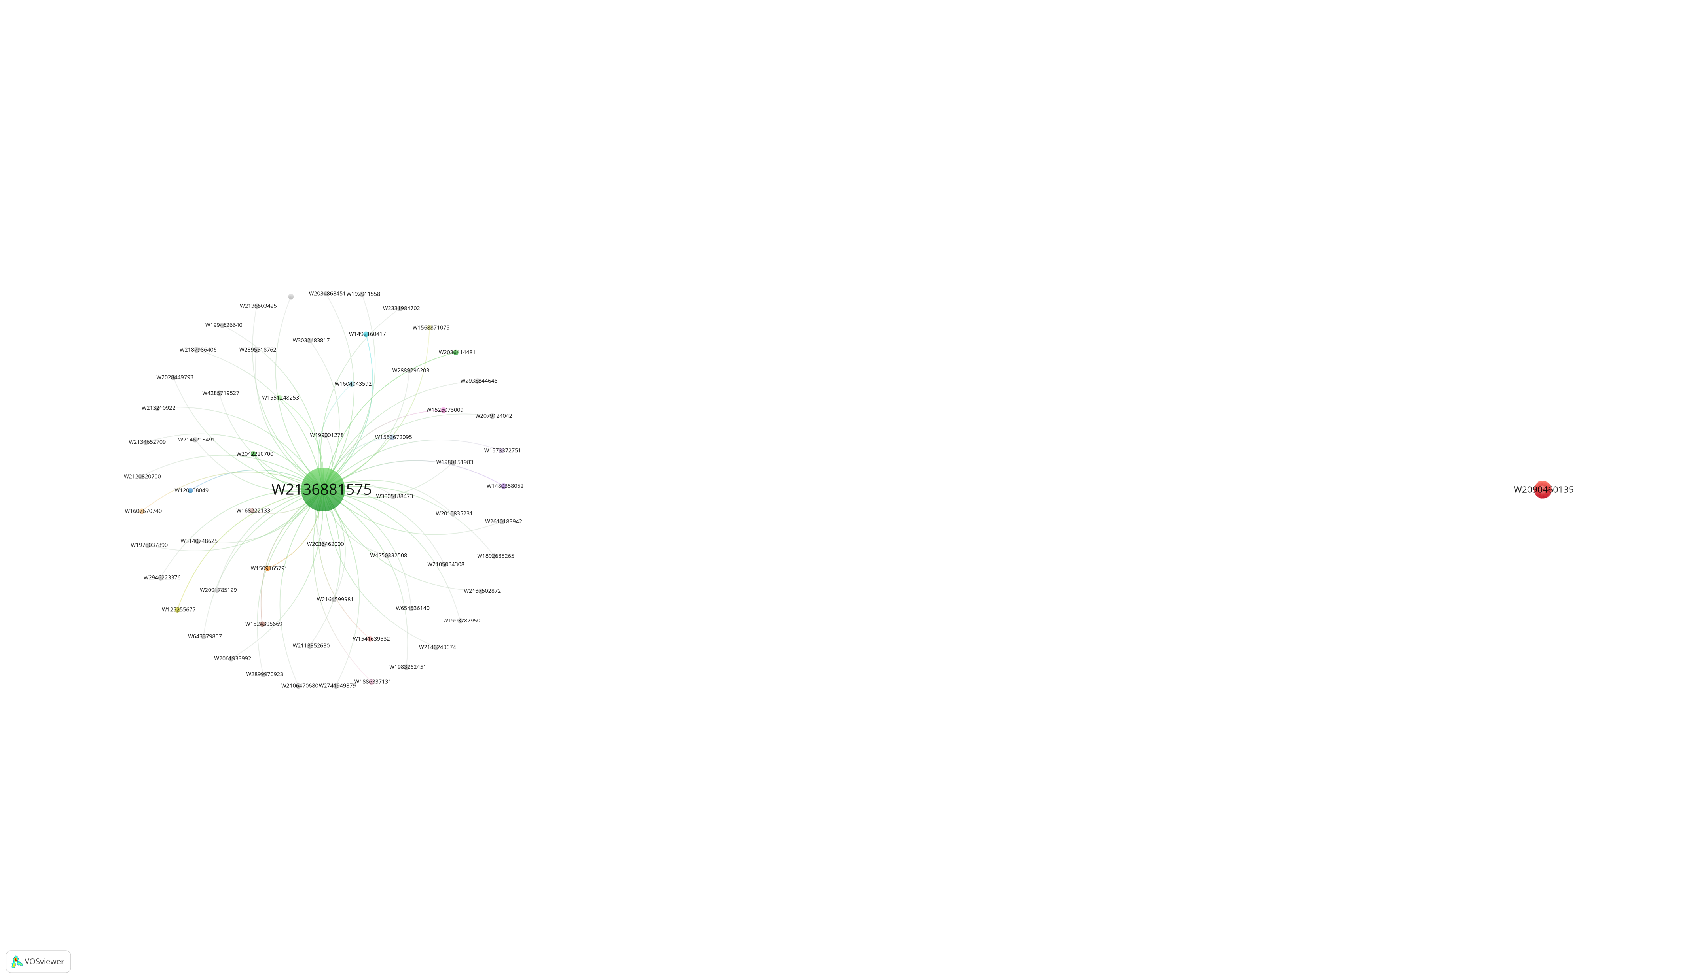
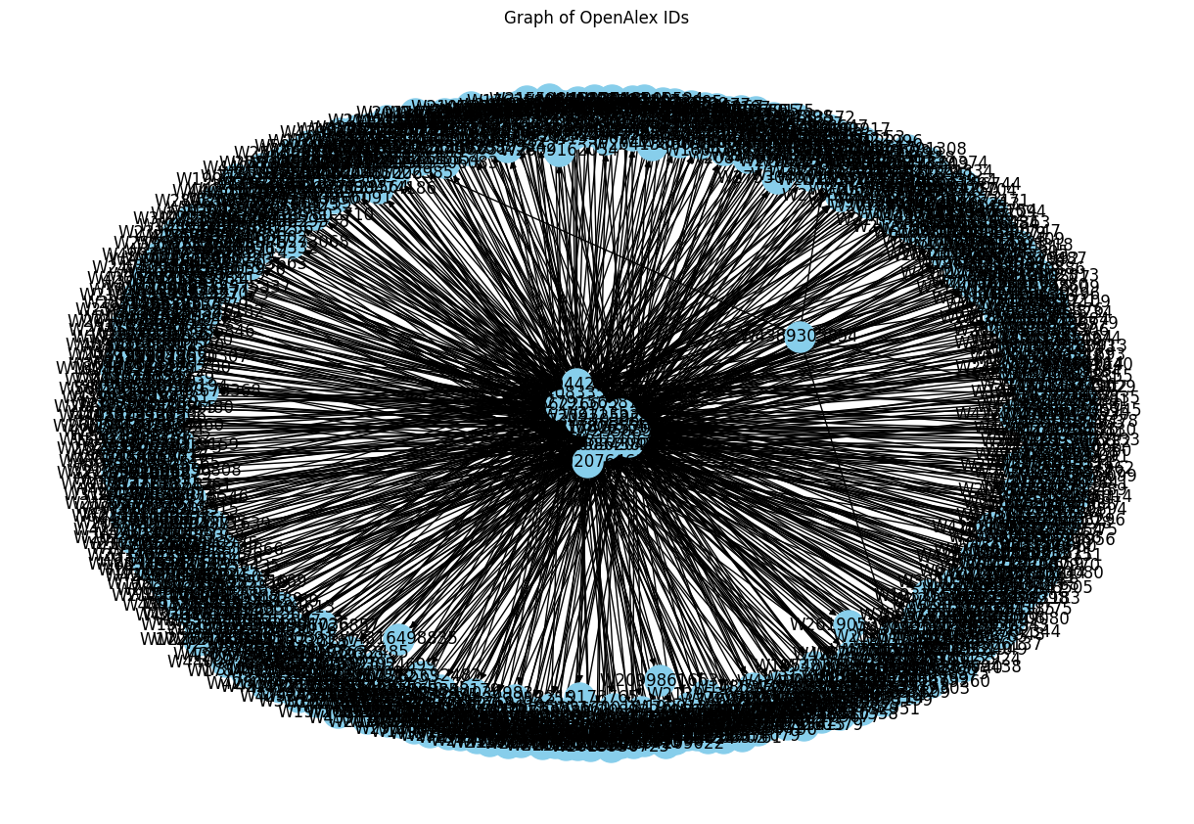
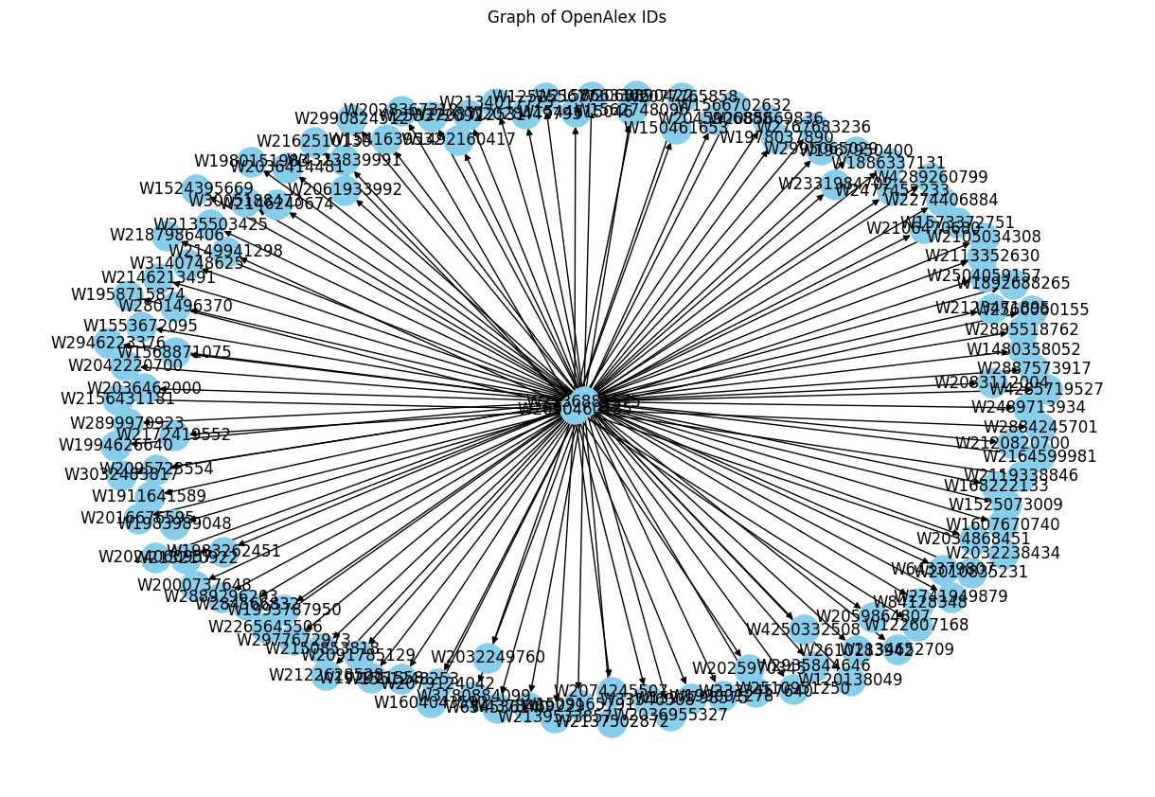

Slide 5
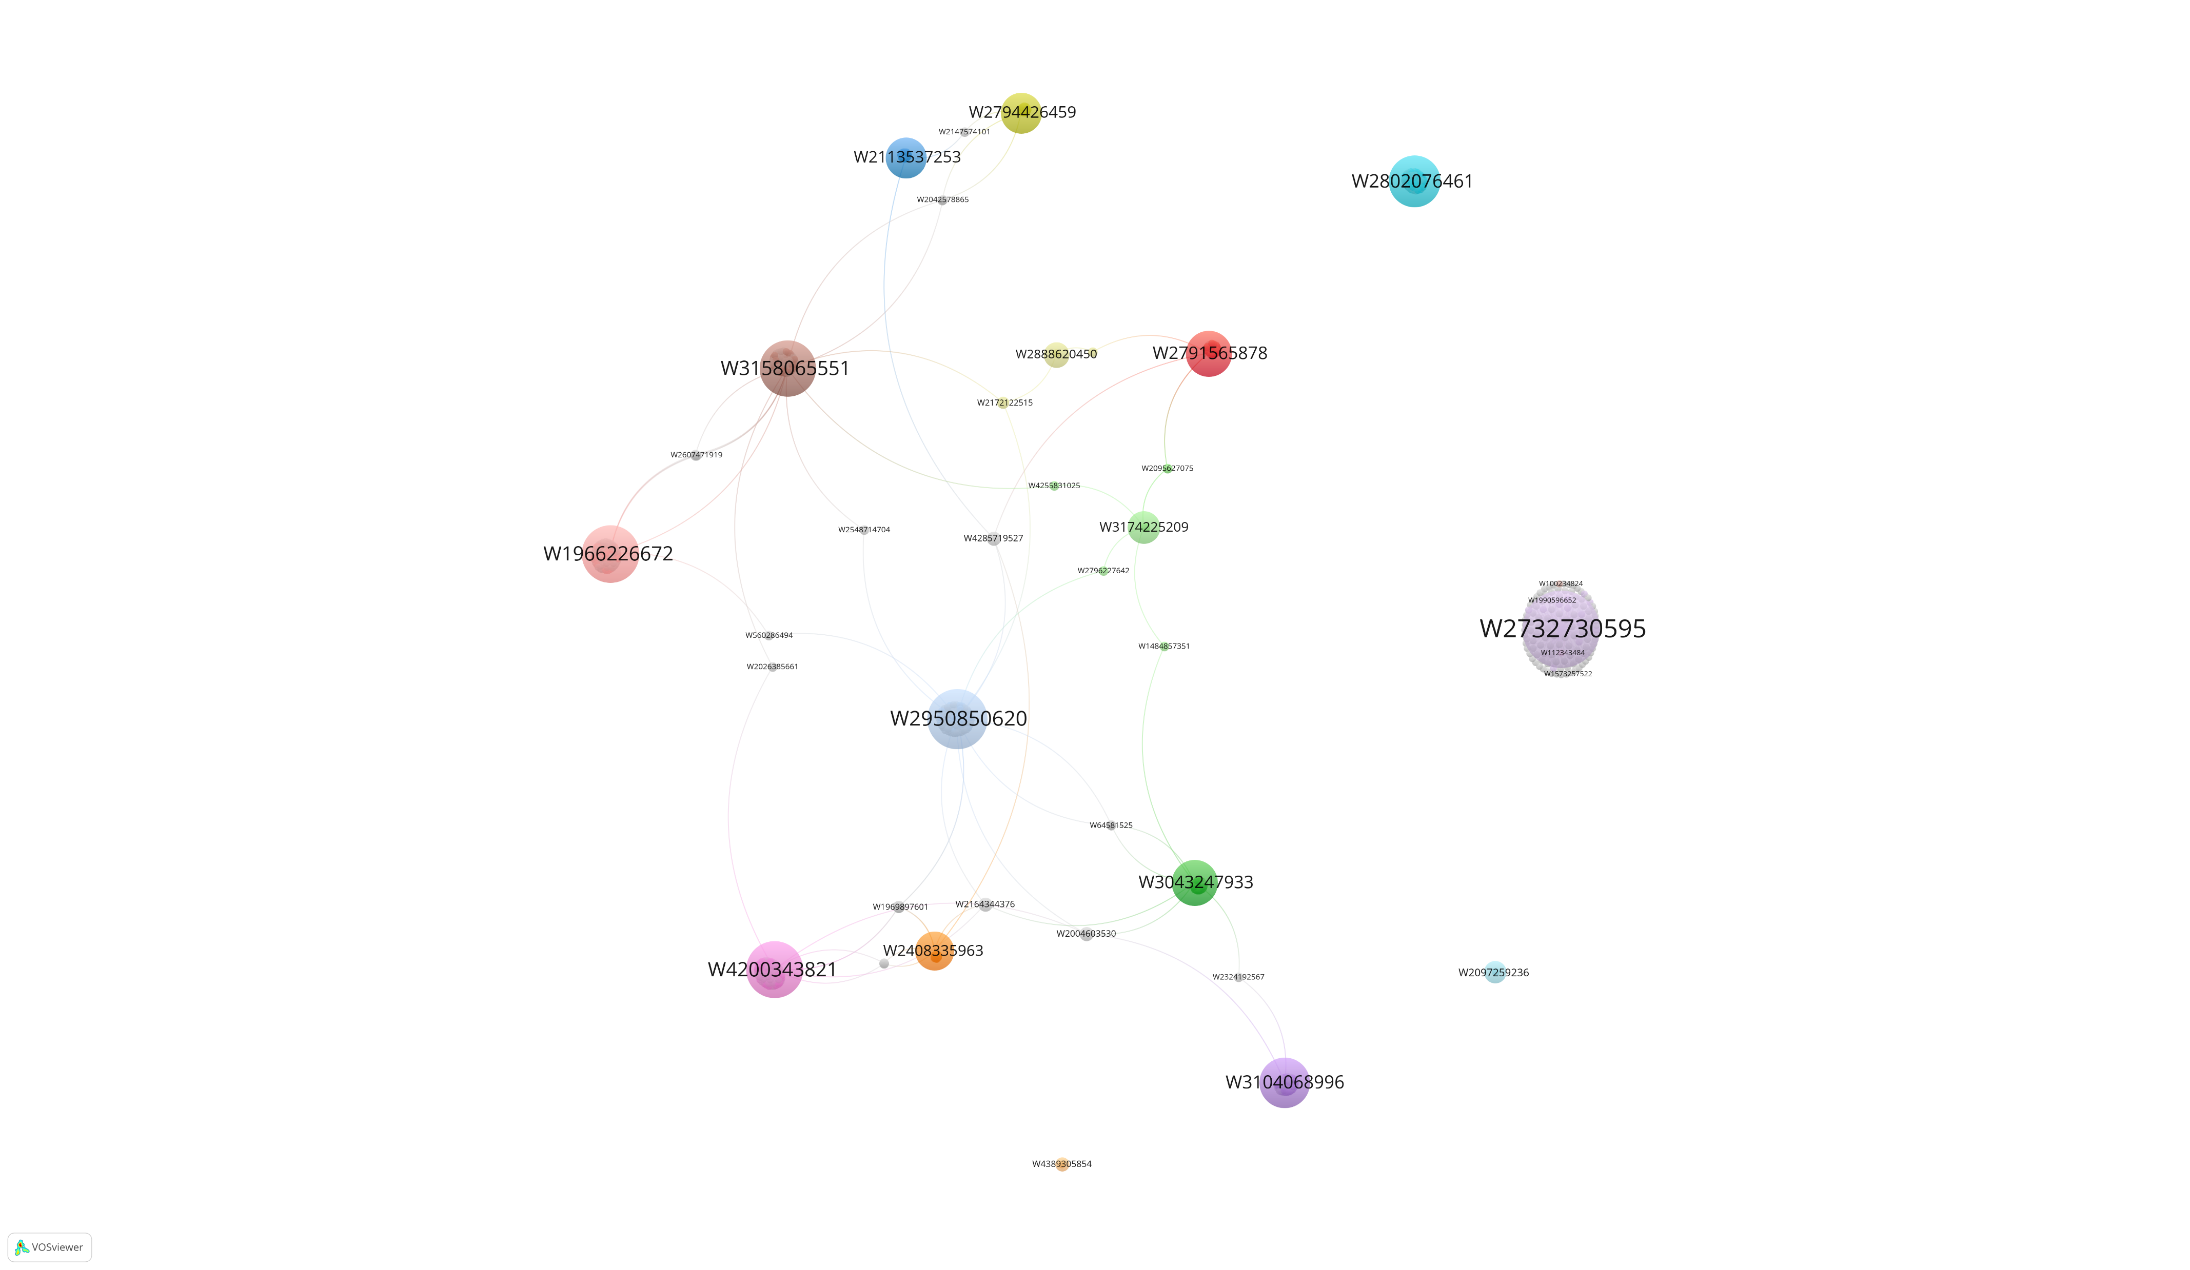
This is my summary
And here is a nice chart to illustrate it

